Slide 1
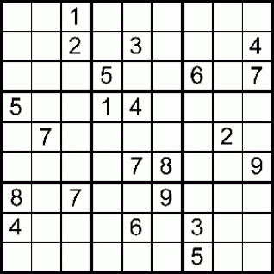
4 | 7 | 8 | 5 | 2 | 3 | 9 | 6 | 1
1
6
3
9 | 2 | 7 | 8 | 3 | 1 | 5 | 4 | 6
 |  |  |  |  |  |  |  | 8
 |  |  |  |  |  |  |  | 3
 |  |  |  |  |  |  |  | 2
2 | 9 | 3 | 7 | 1 | 8 | 6 | 5 | 4
3 |  |  |  |  |  |  |  | 5
2 |  |  |  |  |  |  |  | 7
9 |  |  |  |  |  |  |  | 4
1 |  |  |  |  |  |  |  | 3
8 |  |  |  |  |  |  |  | 6
6 |  |  |  |  |  |  |  | 7
5 |  |  |  |  |  |  |  | 2
4 |  |  |  |  |  |  |  | 8
7 | 2 | 8 | 3 | 4 | 1 | 5 | 6 | 9
2 | 4 | 8 | 3 | 9 | 5 | 7
5 |  |  |  |  |  |  | 4
9 |  |  |  |  |  |  |  | 2
6 |  |  |  |  |  |  |  | 4
3 |  |  |  |  |  |  |  | 8
7 |  |  |  |  |  |  |  | 3
8 |  |  |  |  |  |  |  | 5
1 |  |  |  |  |  |  | 3
4 | 2 | 7 | 9 | 5 | 3 | 8
 |  | 9 | 6 | 5 | 7 | 8
 | 4 |  |  |  |  |  | 9
6 |  |  |  |  |  |  |  | 5
1 |  |  |  |  |  |  |  | 7
2 |  |  |  |  |  |  |  | 3
8 |  |  |  |  |  |  |  | 9
4 |  |  |  |  |  |  |  | 8
 | 8 |  |  |  |  |  | 6
 |  | 1 | 5 | 8 | 4 | 7
3 |  |  |  |  |  |  | 4
5 |  |  |  |  |  | 3
4 |  |  |  |  | 6
9 |  |  |  | 6
6 | 3 | 5 | 7
7 |  |  |  | 5
2 |  |  |  |  | 9
1 |  |  |  |  |  | 8
8 |  |  |  |  |  |  | 3
4 |  |  |  |  |  |  |  | 9
1 |  |  |  |  |  |  |  | 3
9 |  |  |  |  |  |  |  | 1
3 |  |  |  |  |  |  |  | 5
8 |  |  |  |  |  |  |  | 6
6 |  |  |  |  |  |  |  | 8
2 |  |  |  |  |  |  |  | 7
5 |  |  |  |  |  |  |  | 2
7 | 9 | 6 | 1 | 2 | 3 | 5 | 8 | 4
By:
Jeremy Wright
Derek Anderson

Slide 2
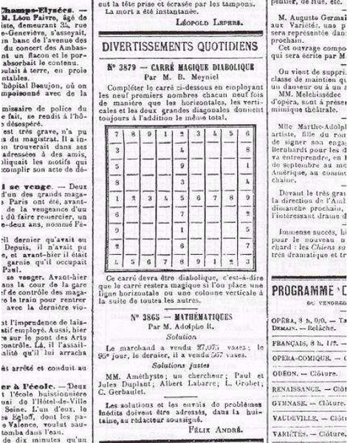
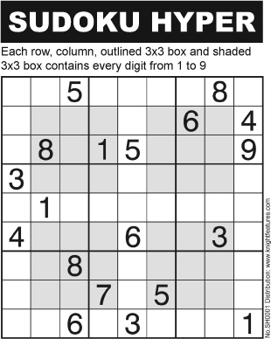
A little history
First created by the French in 1892
The Japanese puzzle company, Nikoli, recreated the puzzle game and popularized it in 1986 called Sudoku, meaning “single number.” It became an international hit in 2005.
Sudoku is in newspapers, magazines, ipods, Video games, etc. all over the world!

Slide 3
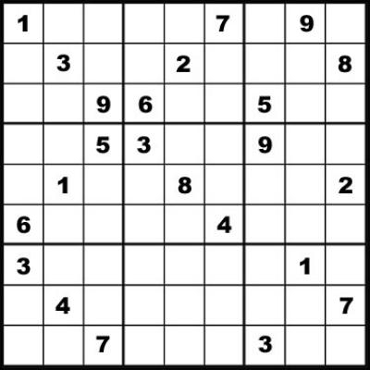
Sudoku Generator
Creates a random Sudoku based on what difficulty you want.
17-26 = Sudoku Master
26-30 = Hard
31-35 = Medium
36-45 = Easy
45-55 = Really?
El Escargot

Slide 4
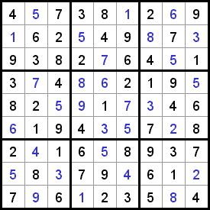
Sudoku Solver
If you get stuck, the solver will tell you the answer.

Slide 5
Interactive Sudoku
You can do the Sudoku right in sage instead of doing it on paper
Makes it a lot easier to fix errors

